Slide 1
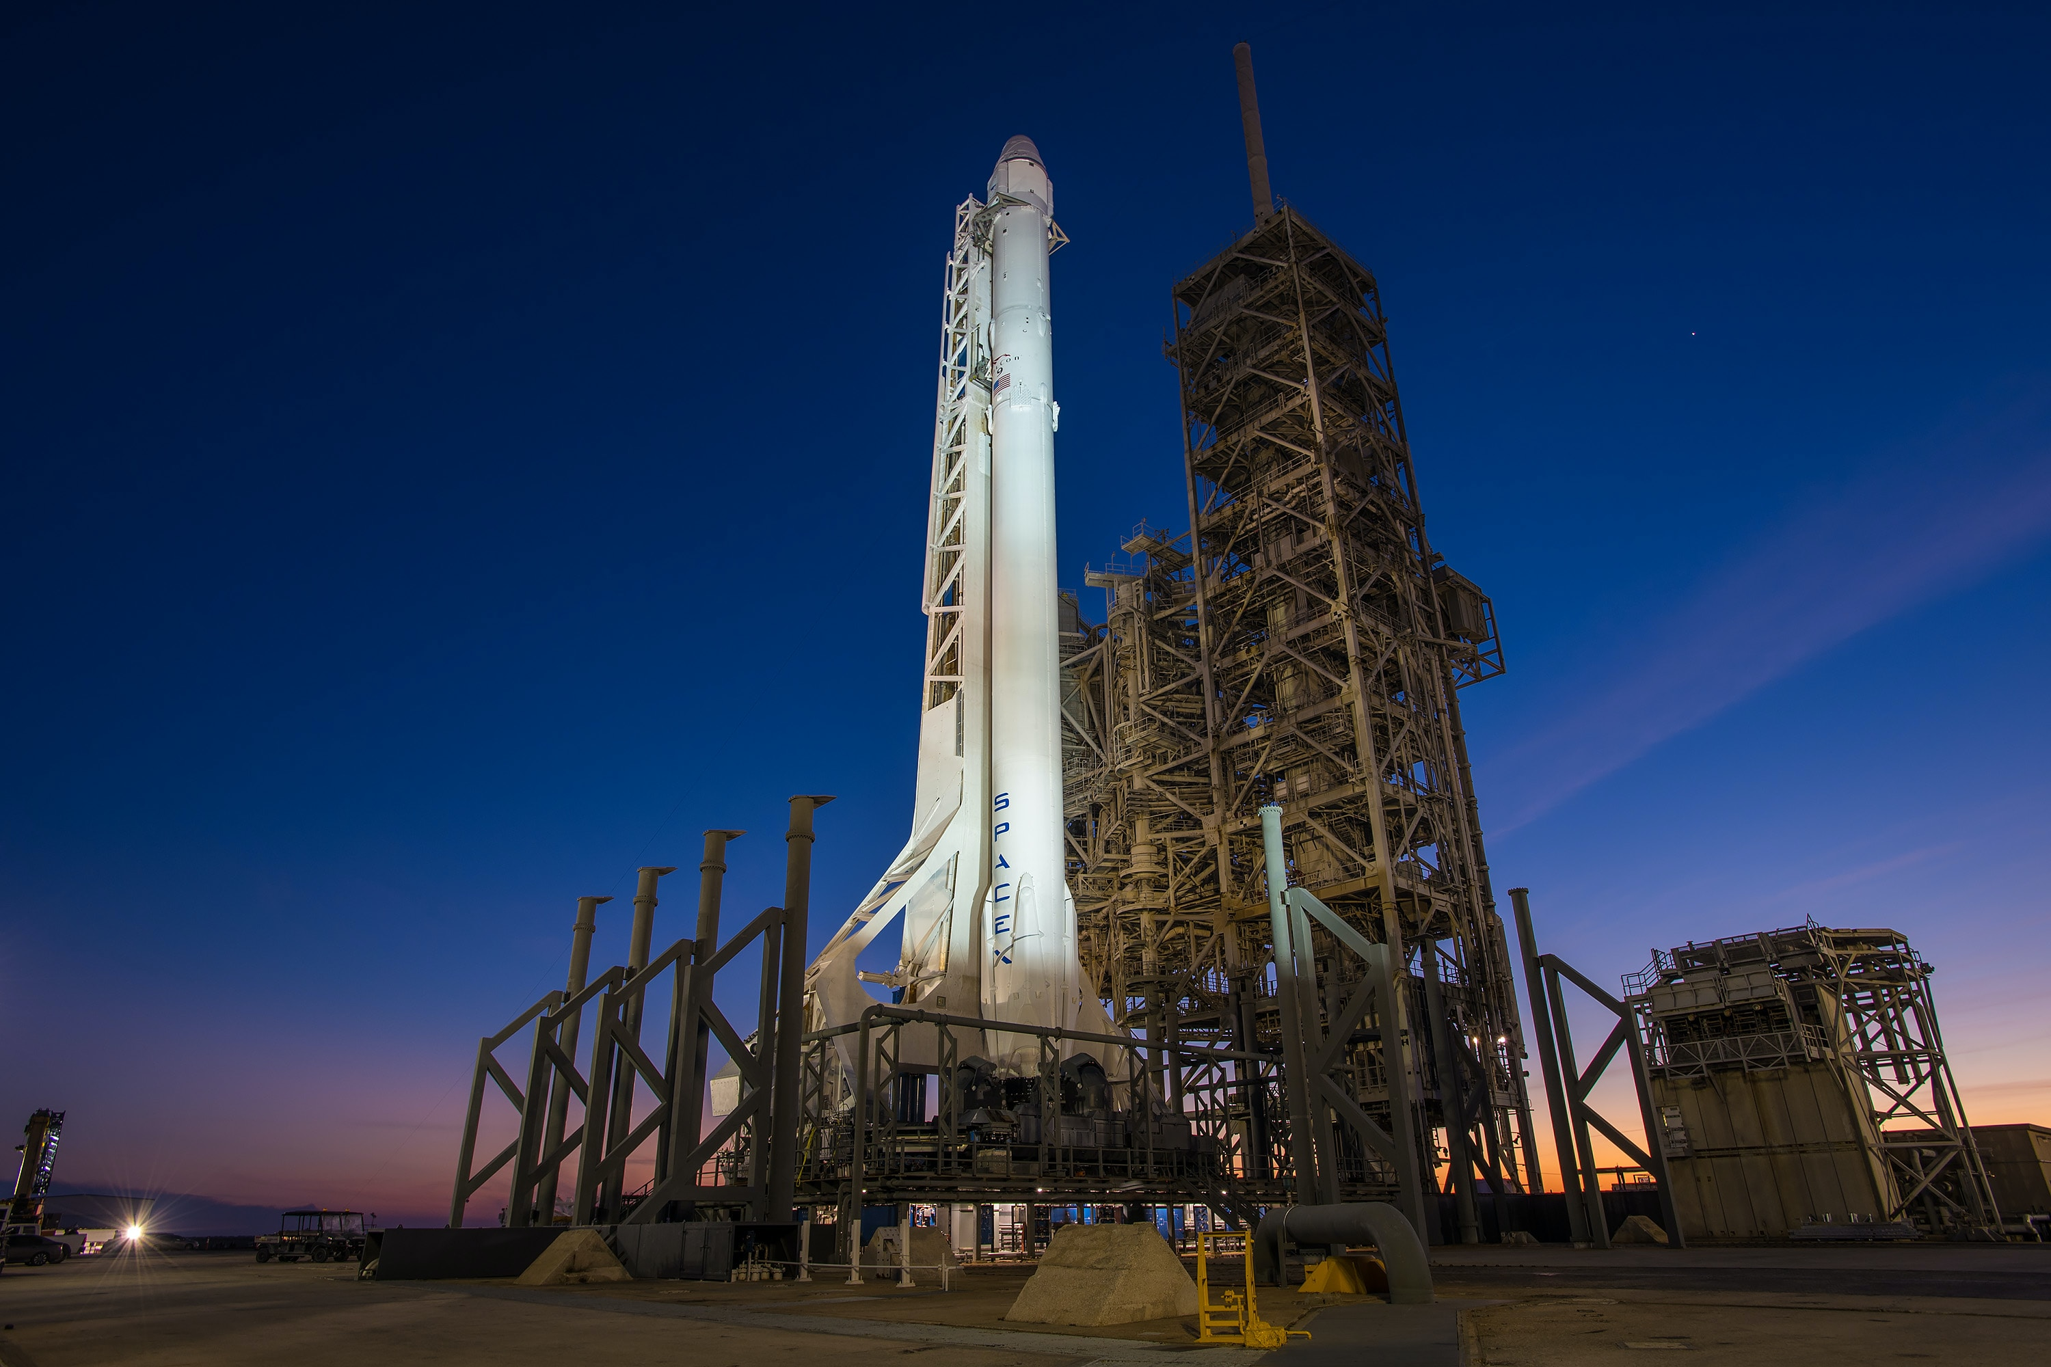

FABRIKAM TECHNOLOGY INC.
Predicting Space X Falcon 9’s
First Stage Landing Success
SUBTITLE GOES HERE
By: Benedict Z. Castro
02/10/2023

Slide 2
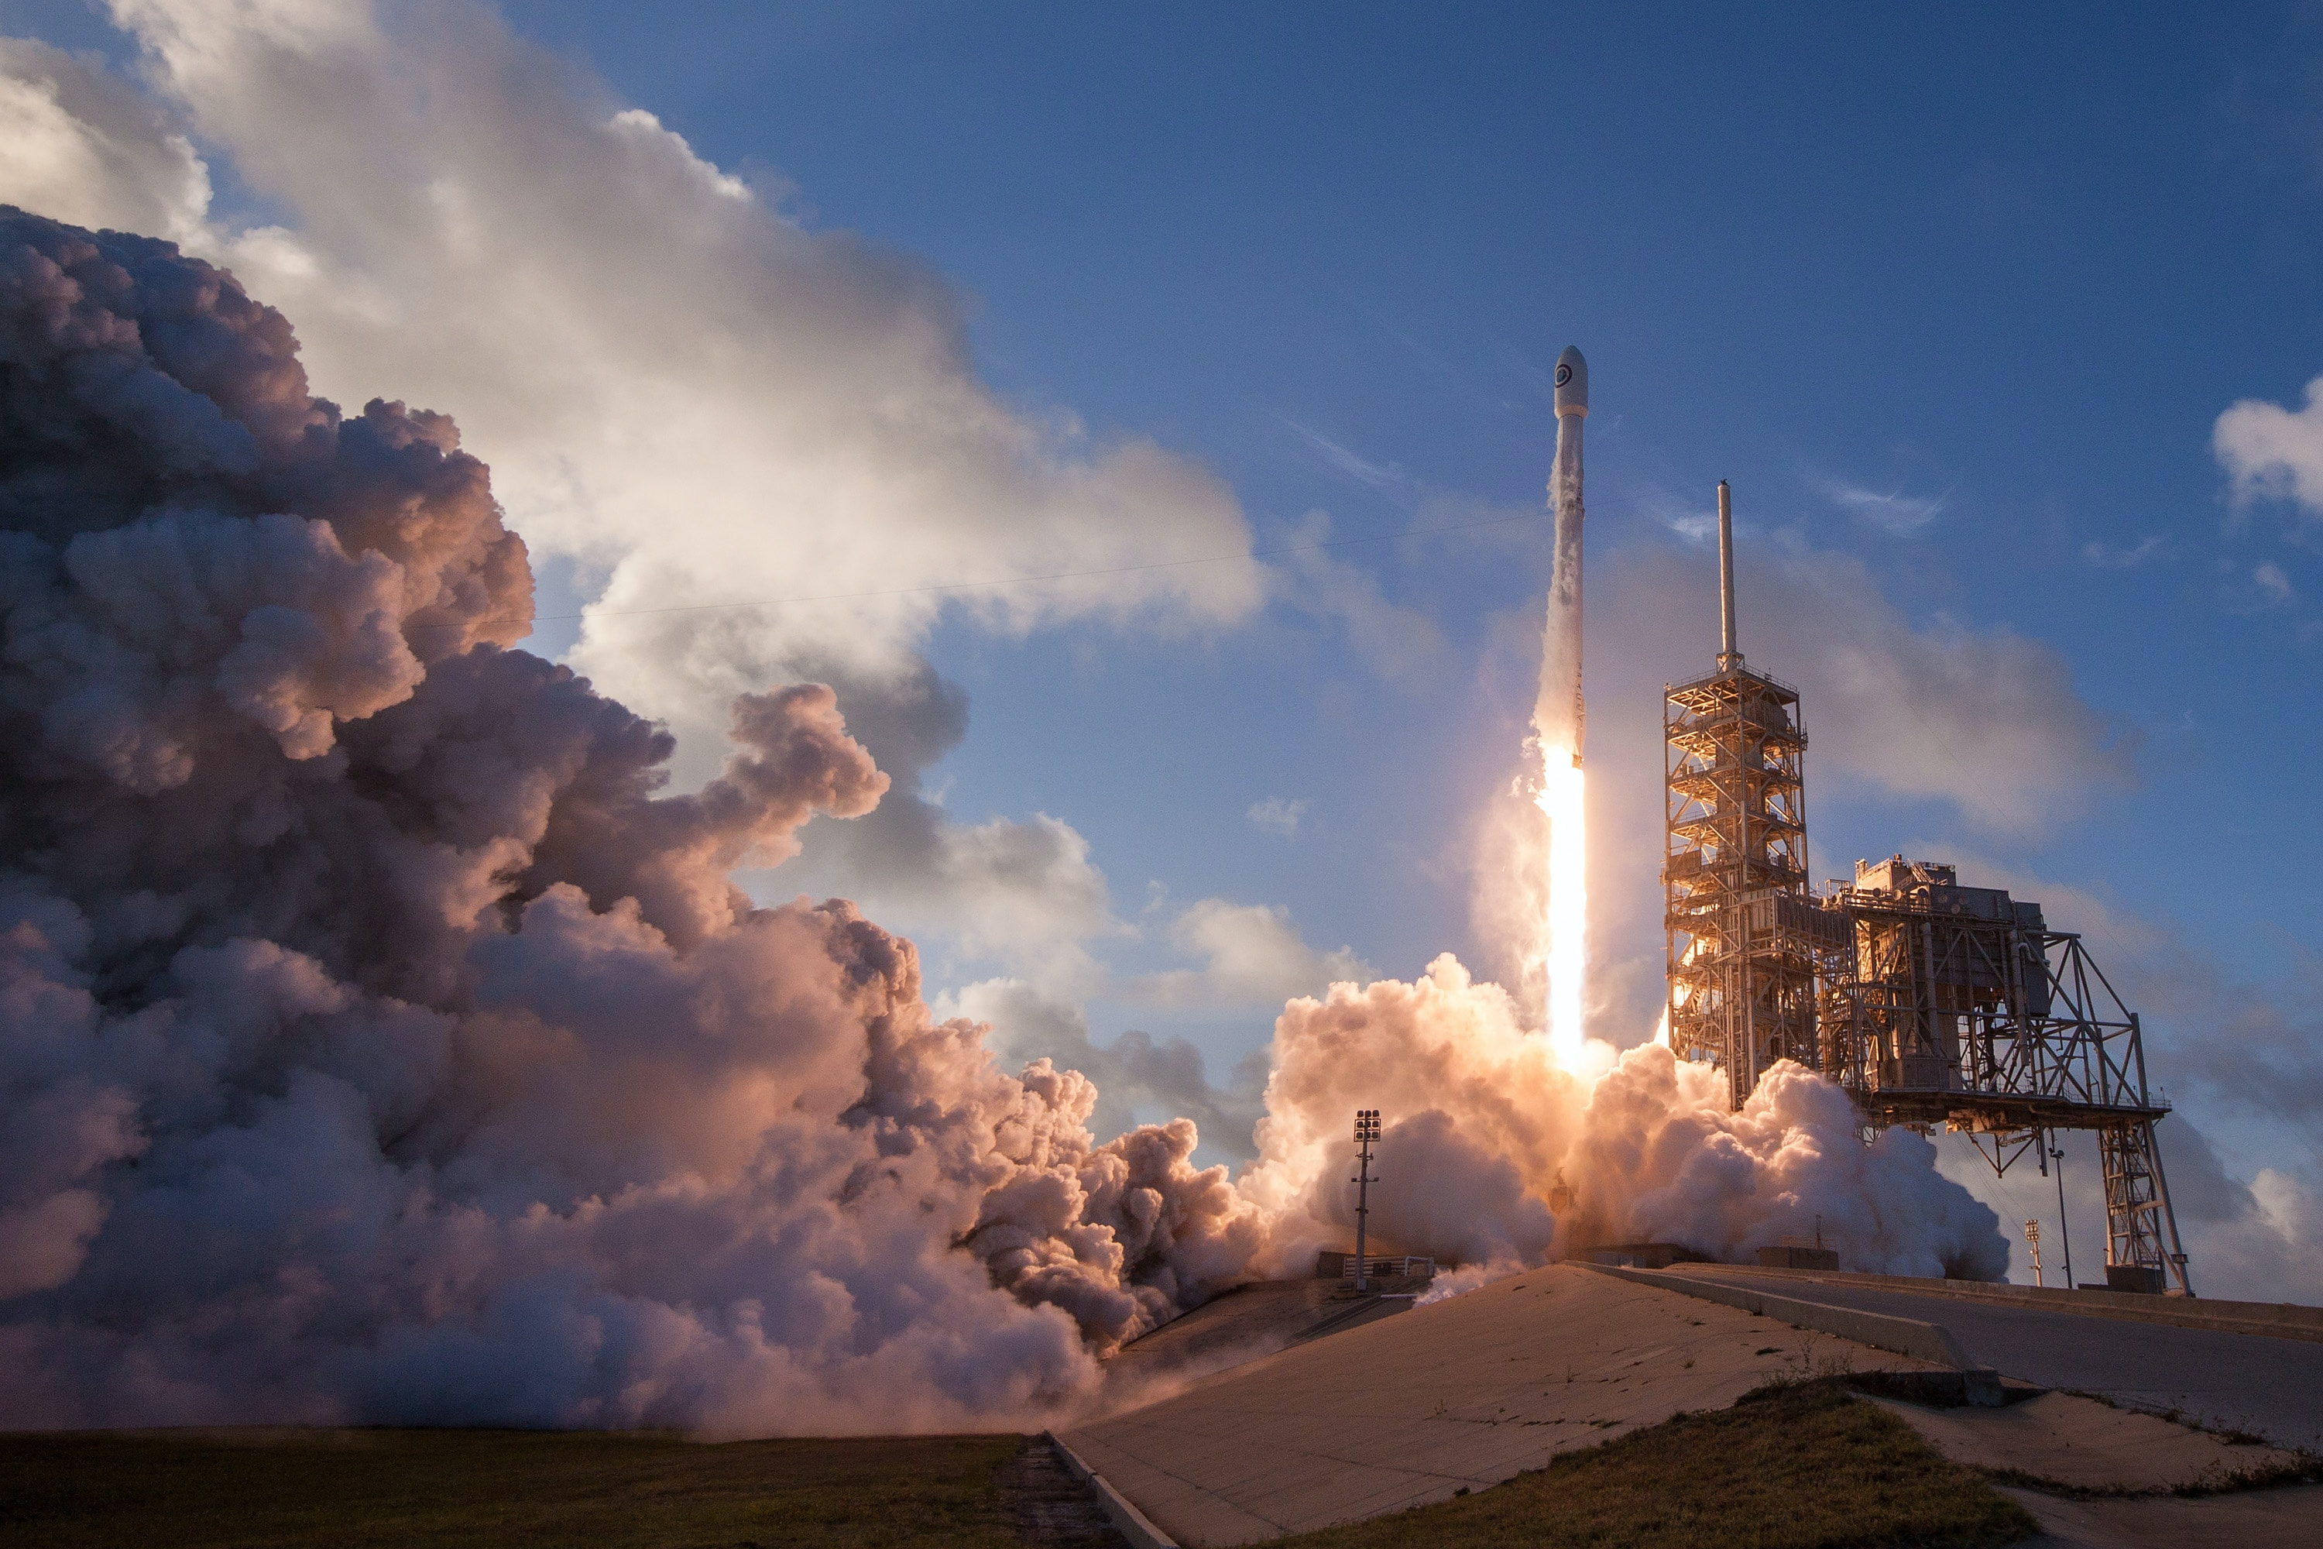
Outline
Executive Summary
Introduction
Methodology
Data Collection
Data Wrangling
Exploratory Data Analysis (EDA)
Interactive Visual Analytics
Machine Learning Models
Results
Conclusion

Slide 3
Executive summary
This research was conducted to study and identify the different data features for a rocket’s successful first stage landing, and to predict the success rate. In order to achieve, these methodologies where employed:
Data collection was done using the SpaceX REST API and through web scraping
Data wrangling was employed to transform raw data to desired form
Exploratory data analysis was performed to visualize key relationships between features which include payload mass, launch site, flight number, and yearly trend
Analysis of data using SQL to calculate metrics like total payload mass, payload ranges for successful launches, and total number of successful and failed outcomes
Visualize launch site success conditions and environments by utilizing geographical markers
Build machine learning models to predict the first stage landing success using logistic regression, support vector machine (SVM), decision tree and K-nearest neighbor

Slide 4
Executive summary
It was observed that:
KSC LC-39A has the highest success rate compared to all landing sites
The orbits ES-L1, GEO, HEO, and SSO exhibited 100% success rates
From the yearly trend, launch success rates have improved
Launch sites were chosen to be close to coastlines
The decision tree model showed the best results, but only slightly outperforming the other predictive models within 5% difference.

Slide 5
Introduction
Background
Space Exploration Technologies Corp., or better known as SpaceX, is a global aerospace industry leader with the purpose of revolutionizing space technology so that it would be accessible for everyone. One of its greatest contributions to humanity include sending astronauts and spacecraft to the International Space Station (ISS).
SpaceX’s Falcon 9 rocket launches are being advertised with inexpensive costs (around 62M dollars) as compared to its other competitors with launch costs roughly around 162M dollars. This was made possible because of their genuine idea of reusing the rocket’s first stage. Thus, it is essential to determine the success rate of the first stage landing in order to estimate the cost of a launch.
Study:
factors that affect the rocket launch’s first stage landing success
relationship between these features with the success rate
predictive models that can be utilized to determine the landing success rate

Slide 6
Methodology

Slide 7
METHODOLOGY
Executive Summary
Data collection methodology:
data was collected using the SpaceX REST API and through web scraping
Perform data wrangling
transforming raw data to usable form through filtering, handling missing values, and applying one-hot encoding
Perform Exploratory Data Analysis (EDA) using visualization and SQL
Perform Interactive Visual Analytics using Folium and Plotly Dash
Perform Predictive Analysis using Classification Models
How to build, tune, and evaluate classification models

Slide 8
METHODOLOGY
Data Collection - API
Requested rocket launch data from SpaceX API
Decoded response content using json functions from pandas
Requested information about the launches using the API and auxiliary functions
Created dataframe from requested data
Cleaned the dataframe
filtered Falcon 9 launches
replaced missing values with calculated mean statistic
exported to a csv file
The link to the notebook flowchart is available here:
https://github.com/benicastro/data-portfolio/blob/main/ibm-data-science/jupyter-labs-spacex-data-collection-api.ipynb

Slide 9
METHODOLOGY
Data Collection – Web Scraping
Requested rocket launch data for Falcon 9 from Wikipedia
Instantiated BeautifulSoup object from HTML response
Collected data by parsing HTML tables
Created dataframe from parsed data
Cleaned the dataframe
Exported to a csv file
The link to the notebook flowchart is available here:
https://github.com/benicastro/data-portfolio/blob/main/ibm-data-science/jupyter-labs-webscraping.ipynb

Slide 10
METHODOLOGY
Data Wrangling
Performed EDA and determined training data labels
Calculated:
number of launches for each site
number and occurrence of orbit, and mission outcome for each orbit type
Created binary labels for landing outcomes
Exported data results to csv
The link to the notebook flowchart is available here:
https://github.com/benicastro/data-portfolio/blob/main/ibm-data-science/jupyter-labs-data-wrangling.ipynb

Slide 11
METHODOLOGY
EDA with Data Visualization
Plotted charts to visualize patterns and identify relationships
Flight Number vs. Payload
Flight Number vs. Launch Site
Payload Mass vs. Launch Site
Payload Mass vs. Orbit Type
Landing Success Rate vs. Orbit Type
The relationship between the said features were analyzed using scatter plots which would later be essential in predicting the landing success
Landing success rates for each orbit were showcased with the use of bar charts for better visualization.
The link to the notebook flowchart is available here:
https://github.com/benicastro/data-portfolio/blob/main/ibm-data-science/jupyter-labs-eda-dataviz.ipynb

Slide 12
METHODOLOGY
EDA with SQL
Determined:
names of unique launch sites
launch sites that start with “CCA”
first successful landing on ground pad
boosters which landed successfully on a drone ship and have 4000 kg < payload mass < 6000 kg.
booster versions which have carried the max payload mass
failed landing outcomes on a drone ship (including booster version and launch site) in 2015
Calculated:
total payload mass carried by boosters launched by NASA (CRS)
average payload mass carried by booster version F9 v1.1
count of landing outcomes between 2010-06-04 and 2017-03-20 in descending order
The link to the notebook flowchart is available here:
https://github.com/benicastro/data-portfolio/blob/main/ibm-data-science/jupyter-labs-eda-sql-coursera_sqllite.ipynb

Slide 13
METHODOLOGY
Interactive Map with Folium
Launch sites were marked with circle map objects – blue circle at NASA Johnson Space Center and red circles at all launch sites – with popup labels indicating their coordinates or location
Launch outcomes were marked – green if successful and red if unsuccessful – using clusters to identify launch sites with high success rates
Marker lines were used to show the distances between launch site CCAFS SLC-40 and establishments like coastlines, railways, highways, and cities to assess location factors
The link to the notebook flowchart is available here:
https://github.com/benicastro/data-portfolio/blob/main/ibm-data-science/jupyter-labs-launch-site-location.ipynb

Slide 14
METHODOLOGY
Dashboard with Plotly Dash
Added dropdown list of launch sites to allow users to access data for specific sites or for all sites
Created a pie chart to depict successful and unsuccessful launches as part of a whole
Added a slider for payload mass range to easily navigate between different ranges
Created a scatter plot showing the relationship between the outcome result and payload mass for the different booster versions
The link to the notebook flowchart is available here:
https://github.com/benicastro/data-portfolio/blob/main/ibm-data-science/jupyter-labs-interactive-dashboard-with-plotly-dash.ipynb

Slide 15
METHODOLOGY
Predictive Analysis (Classification)
Created a NumPy array from the class data column
Standardized and transformed the data using StandardScaler and transform
Split the data into training and testing using train_test_split
Created a GridSearchCV object to perform parameter optimization
Performed GridSearchCV for different algorithms
Logistic Regression
Support Vector Machine
Decision Tree
K-Nearest Neighbor
Calculated accuracy scores for all models with test data
Created confusion matrices for all models
Assessed the best performing classification model through feature engineering and algorithm tuning and using accuracies scores as metric
The link to the notebook flowchart is available here:
https://github.com/benicastro/data-portfolio/blob/main/ibm-data-science/jupyter-labs-predictive-analysis.ipynb

Slide 16
Results
Exploratory data analysis results
Interactive analytics demo in screenshots
Predictive analysis results

Slide 17
Insights drawn from EDA

Slide 18
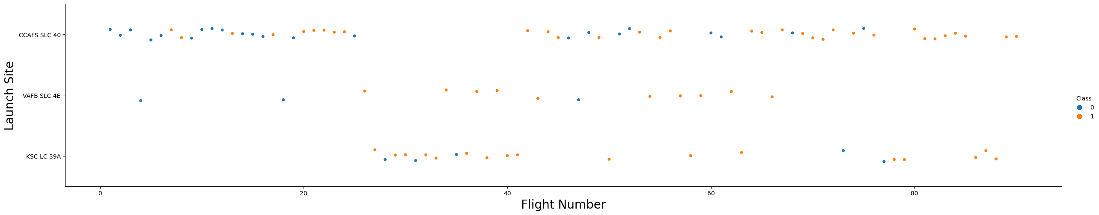
results
Flight Number vs. Launch Site
It can be seen that with increasing flight number for a specific launch site, the greater the success rate.
earlier flights had a lower success rate
later flights had a higher success rate
It can be inferred that new launches can lead to higher success rates

Slide 19
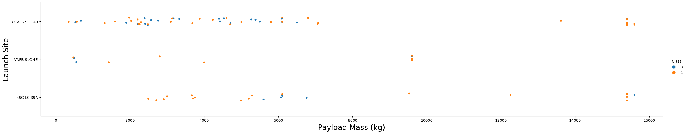
results
Payload vs. Launch Site
The greater the payload mass, the higher the success rate
Launches with payload masses less than 5,000 kg for KSC LC 39A have 100% success rate
It can be observed that majority of launches with payload masses greater than 7,000 kg have relatively high chances of success

Slide 20

results
Success Rate vs. Orbit Type
Four orbit types have 100% success rate:
ES-L1
GEO
HEO
SSO
Only the SO orbit type have 0% success rate

Slide 21
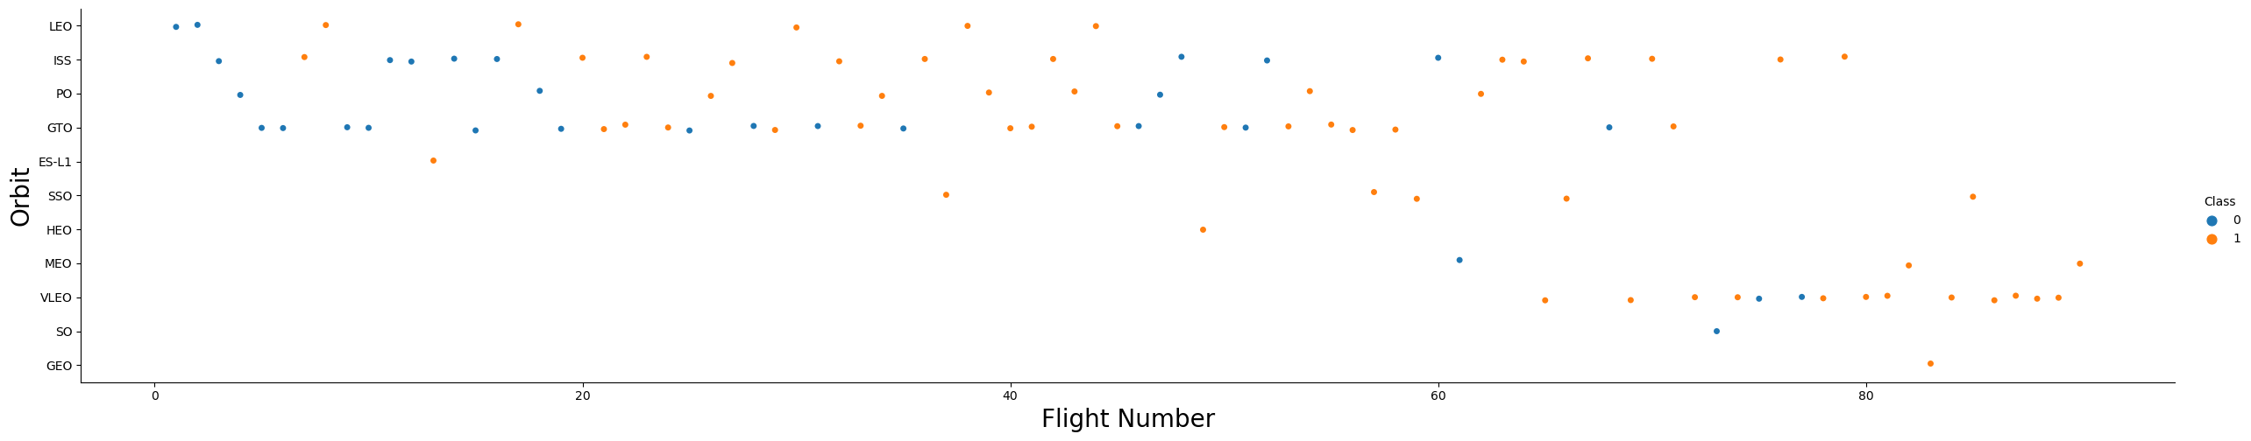
results
Flight Number vs. Orbit Type
Generally, with increasing flight number, the success rate also increases as evident in the LEO orbit.
The GTO orbit is an exception to this as there is no apparent relationship between the two variables.

Slide 22
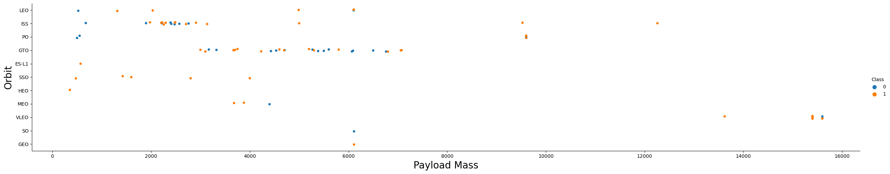
results
Payload vs. Orbit Type
It can be seen that for majority of the launches in the orbits ISS, LEO, and PO, the heavier the payloads, the higher the chances of success

Slide 23
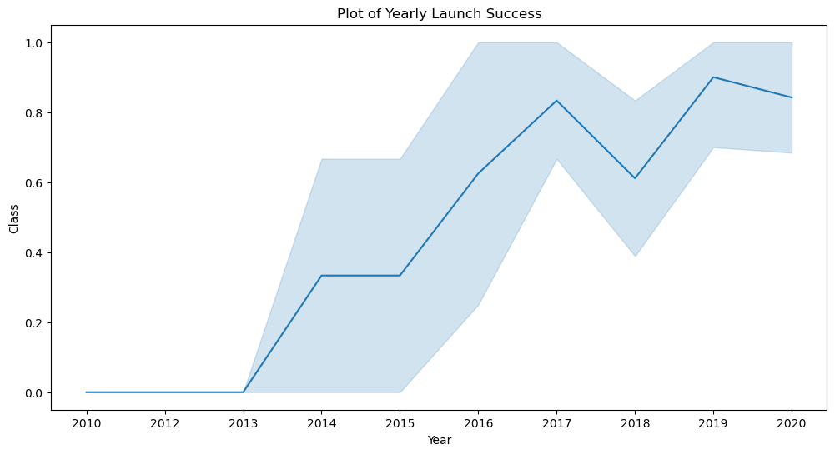
results
Launch Success Yearly Trend
It can be observed that starting from 2013, the success rate steadily increases until 2020, with a dip during 2017-2018

Slide 24
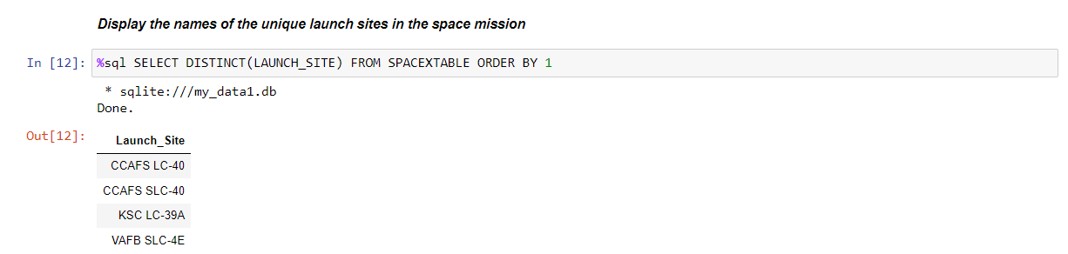
results
All Launch Site Names
The DISTINCT keyword was used to show only the unique launch sites from the data

Slide 25
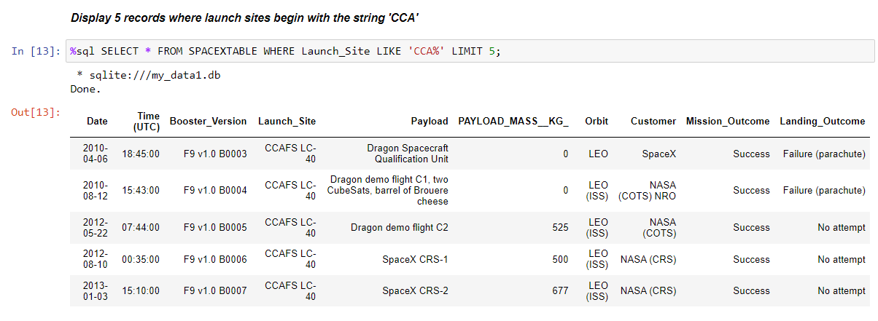
results
Launch Site Names Beginning with “CCA”
The LIKE keyword was used together with the condition keyword WHERE to query the data

Slide 26
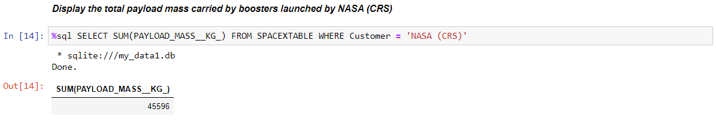
results
Total Payload Mass
The total payload mass is calculated to be 45,596 kg.

Slide 27
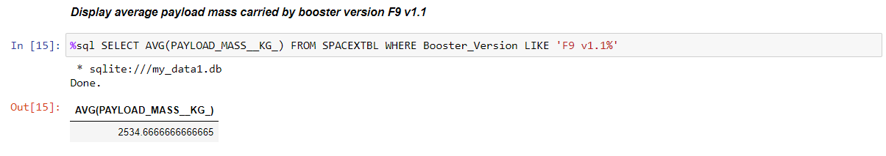
results
Average Payload Mass by F9 v1.1
The average payload mass carried by booster version F9 v1.1 is calculated to be ~2534.67.

Slide 28
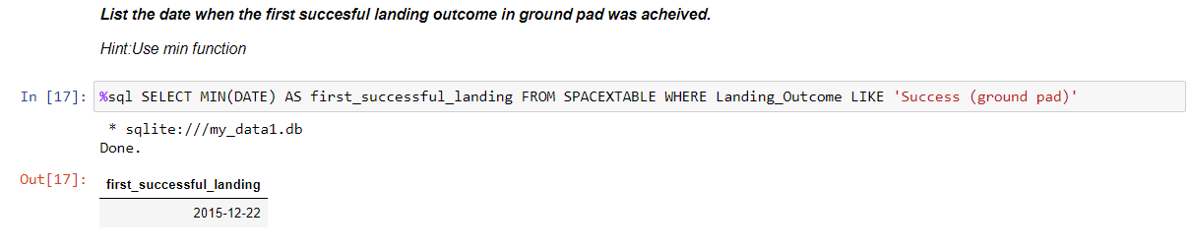
results
First Successful Ground Landing Date
The first successful landing on a ground pad happened on the 22nd of December 2015.

Slide 29
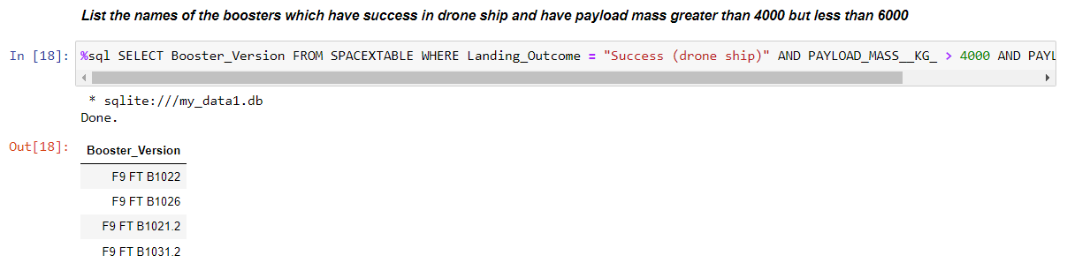
results
Successful Drone Ship Landing with Payload between 4000 and 6000
The conditional keyword WHERE was used, together with the logical operator AND to filter the booster versions needed.

Slide 30
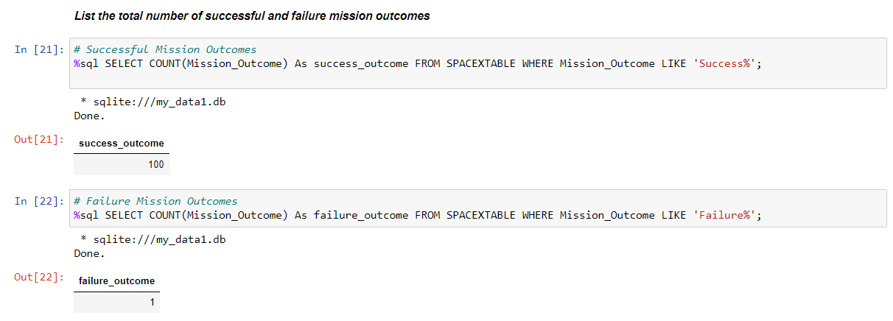
results
Total Number of Successful and Failure Mission Outcomes
The conditional keyword WHERE was again utilized with the keyword LIKE and wildcard % to retrieve the number of mission outcomes.

Slide 31
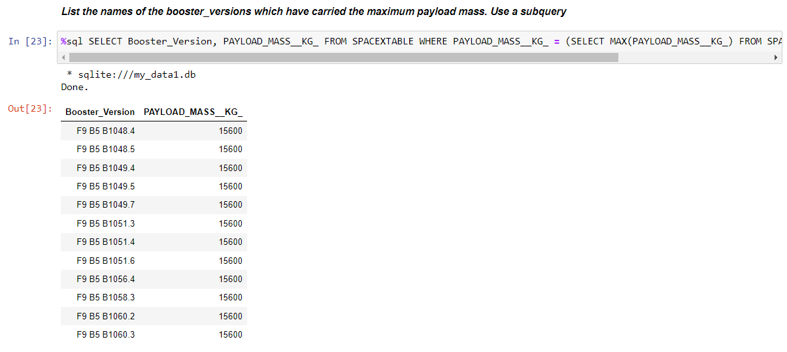
results
Boosters Carrying Maximum Payload
This query was done with the help of the MAX() function inside a subquery.
The maximum payload mass was 15,600 kg.

Slide 32
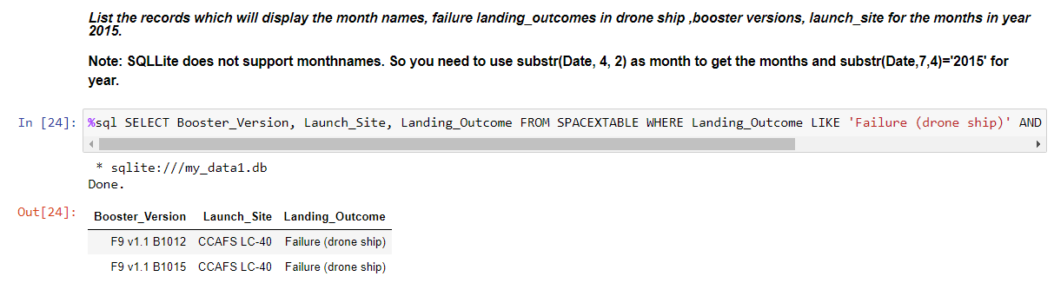
results
2015 Launch Records
For this query, the keywords WHERE, LIKE, AND, and BETWEEN were used to filter the needed data.

Slide 33
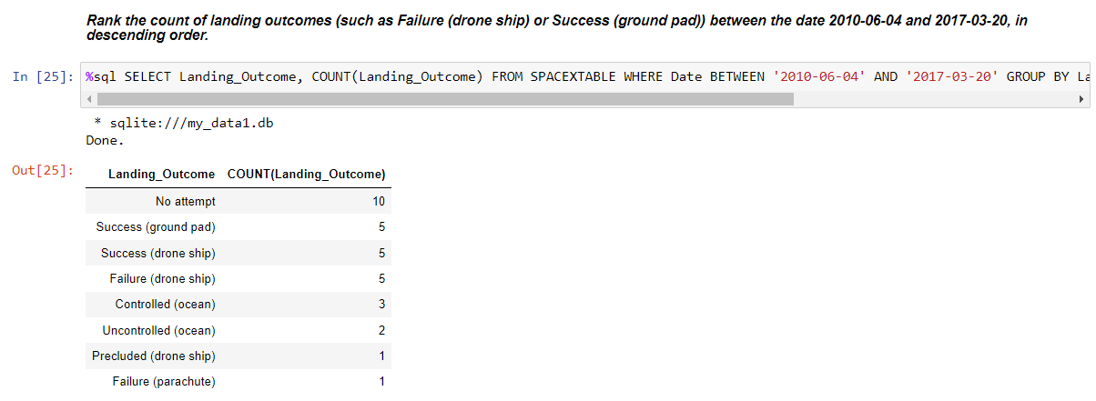
results
Rank Landing Outcomes Between 2010-06-04 and 2017-03-20
The GROUP BY and ORDER BY keywords were utilized in this query to retrieve the ranking of landing outcomes.

Slide 34
Launch Sites
Proximities Analysis

Slide 35
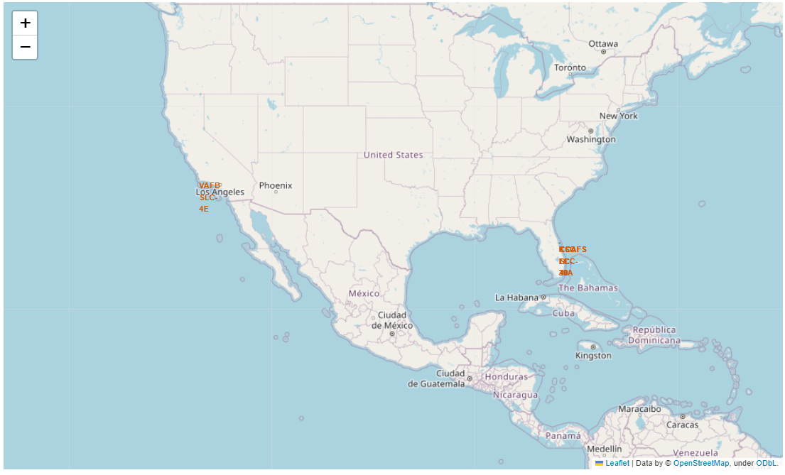
results
All Launch Sites Global Map Markers
The launch sites for SpaceX are located near coastlines as seen in the figure.
Markers were used in order to identify every launch site for better understanding.

Slide 36
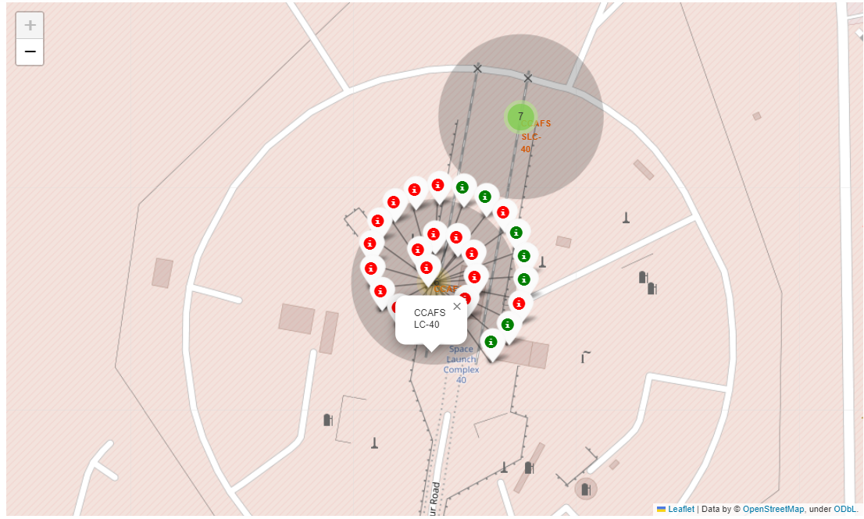
results
Launch Site Markers
CCAFS SLC-40 Launch Site
Green Markers show successful launches while Red Markers show failed launches

Slide 37
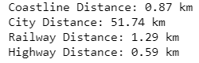
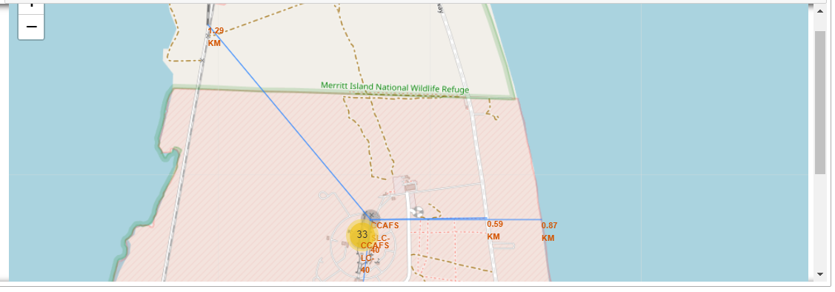
results
Launch Site Distance to Proximities
Launch sites are:
not in close proximity to railways
not in close proximity to highways
in close proximity to coastlines
kept in certain distance away from cities

Slide 38
Build a Dashboard
with Plotly Dash

Slide 39
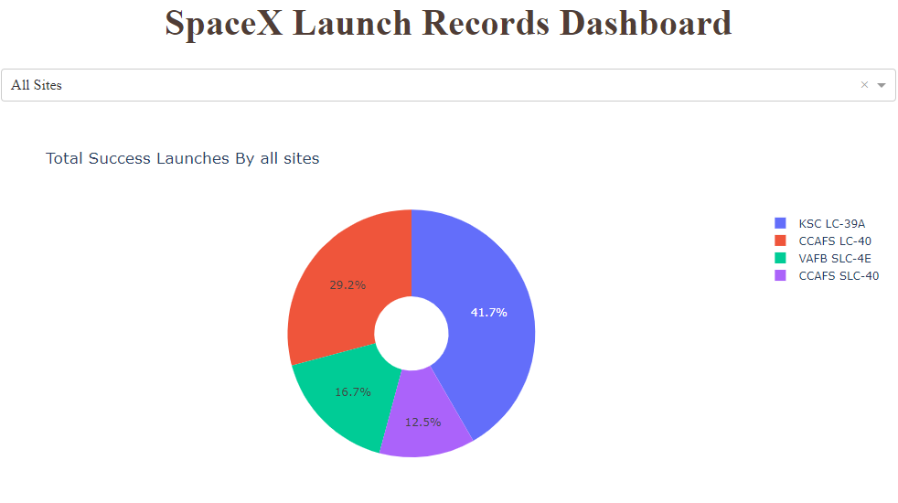
results
Launch Success by Site
It can be seen that KSC LC-39A has the most number of successful launches compared to other launch sites, with around 41.7% of the total.

Slide 40
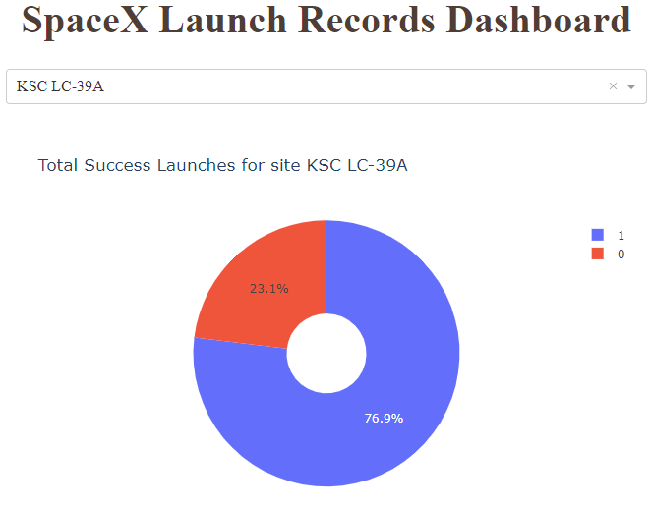
results
Launch Success for KSC LC-39A
Upon inspection, it was found out that KSC LC-39A had the highest success rate with around 76.9%.

Slide 41
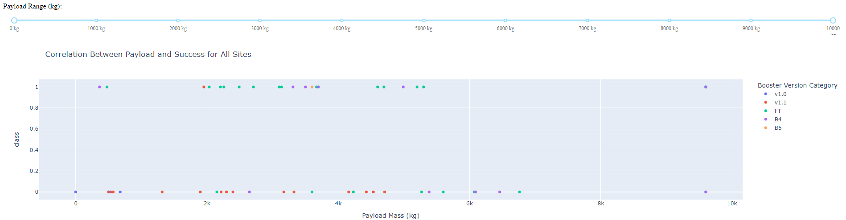
results
Payload Mass vs. Launch Outcome for All Sites
by Booster Version
The success rates for launches with small payload masses are relatively higher than the launches with heavy payload masses.
Specifically, payload masses between 2,000 kg and 5,000 kg have the highest values for success rate

Slide 42
Predictive Analysis (Classification)

Slide 43
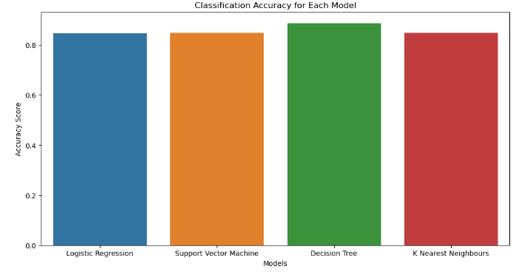
RESULTS
Classification Accuracy
It can be observed that all the predictive models performed relatively at the same level as based on their accuracy scores (.best_score_) with differences of only about 4%.
It can be recalled that the dataset used was small, and thus, may account for these findings.
The Decision Tree Model had the highest classification accuracy, slightly outperforming the other models.

Slide 44
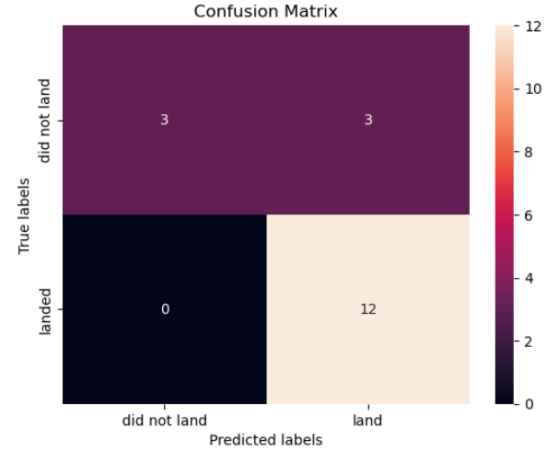
RESULTS
Confusion Matrix
It was noted that all the confusion matrices from the different models were the same
One major problem with the results is the presence of false positives (Type I error) where unsuccessful landing outcomes were marked as successful by the classifier.

Slide 45
Conclusions
As the flight number increases, the success rate also improves across all sites.
Launch success rates increase overtime, starting from 2013 till 2020.
Launch sites are strategically placed close to coastlines.
KSC LC-39A had the most number of successful launches.
The orbits ES-L1, GEO, HEO, and SSO boast a 100% success rate.
Launches with higher payload mass have relatively higher success rates.
All the predictive models yielded almost the same results with the Decision Tree classifier slightly outperforming the rest with 4% difference

Slide 46
Thank You!

